Slide 1

Automated Path Discovery and Guidance
Group Members:
Tong Mu, Gary Zhang, Ashkan Hadian
EE180D Networked Embedded Systems Design

Slide 2
Product Development Mission Background
Our mission is to determine the conditions and quality of paths between two points in order to find the optimal path.
Current navigation is based on maps and pre-existing data, but this existing data lacks updated information about the quality of a particular route.
We are using a combination of robots, ultrasonic sensors, and IR beacons to provide feedback to map the paths through a maze.

Slide 3
Product Development Mission Background
Our product will provide immediate assistance to the visually impaired to navigate through unfamiliar areas, to delivery robots on the street and indoors, and even to hikers trying to find their way through a park or trail.
We are very eager to present and share our two quarters of hard work with you today.

Slide 4
Design Overview: Technical Challenges
Technical challenges that we have encountered included:
Ultrasonic sensor detection -- Having the robot follow non-straight or rounded surfaces and interpret corners.
Path detection.
How can we distinguish between two separate paths?
How can we navigate from one path onto another?
IR beacon placement -- What is the most efficient way to place these beacons on our paths?
Transmitter-Receiver synchronization and communication.
How to use information from multiple senders on the beacon and multiple receivers on the robot.

Slide 5
Design Overview: Technical Challenges
Technical challenges that we have encountered included:
Controlling the robot and ensuring it stays in the center of the path.
Using the ultrasonic sensors and IR beacons to circle the beacon at each intersection to map out all the paths of the intersection.
Various hardware issues using the Edison and the GPIO board
PWM signal too weak.
Internal pull down resistor too large for our capabilities.
Motor power and overheating

Slide 6
System Implementation: Complete Description
Beacon
Robot
Edison
Transmitter
Receiver
Edison 2
Motors
Transmitter
Receiver
Thread 1
Thread 2
(control)
Transmitter
Receiver
Amplifier
Transmitter
Receiver
Edison 1
9DOF
Receiver
Thread 1
Thread 2
Transmitter
Transmitter
Receiver
Ultrasonic
Ultrasonic
Ultrasonic
IR: Biphase Mark Encoding
Edisons: UART
Ultrasonic
Ultrasonic

Slide 7
System Implementation: Complete Description
Currently, we have multiple IR beacons that readily broadcast their identity and the number of paths at their intersection.
For added reliability and security reasons, we begin by broadcasting a specific sequence of bits, followed by the beacon’s identity (A, B, etc) and path amount.
It is up to the receiver to correctly detect and decipher these bits, then communicate with the robot in tandem with the ultrasonic sensors to circle beacons and determine paths.
Meanwhile, the ultrasonic sensors and custom switch-statement controller will keep the robot from bumping into walls.

Slide 8
System Implementation: Complete Description
Due to the unforeseen complexity of the implementation required, the robot is currently told which path to take at each intersection.
A future goal if more time were available would be to have the robot dynamically and autonomously traverse paths until all paths were mapped.
Along each path, the robot records to a file the time it take to traverse each path and the the start and end beacon of the path.

Slide 9
Testing and Verification: Complete System
To test the robot, we will build our own maze consisting of paths and Intersections.
There will be a variety of different path conditions to imitate all possible terrains.
Different terrains include smooth roads, bumpy roads, smooth ramps, and bumpy ramps.
Intersections will have beacons outputting their identity and the number of paths connected to their intersection.
We will have the robot traverse this maze by taking turns manually programmed in at each intersection.
The robot will take and record path data along each path and output the data to a .txt file.

Slide 10
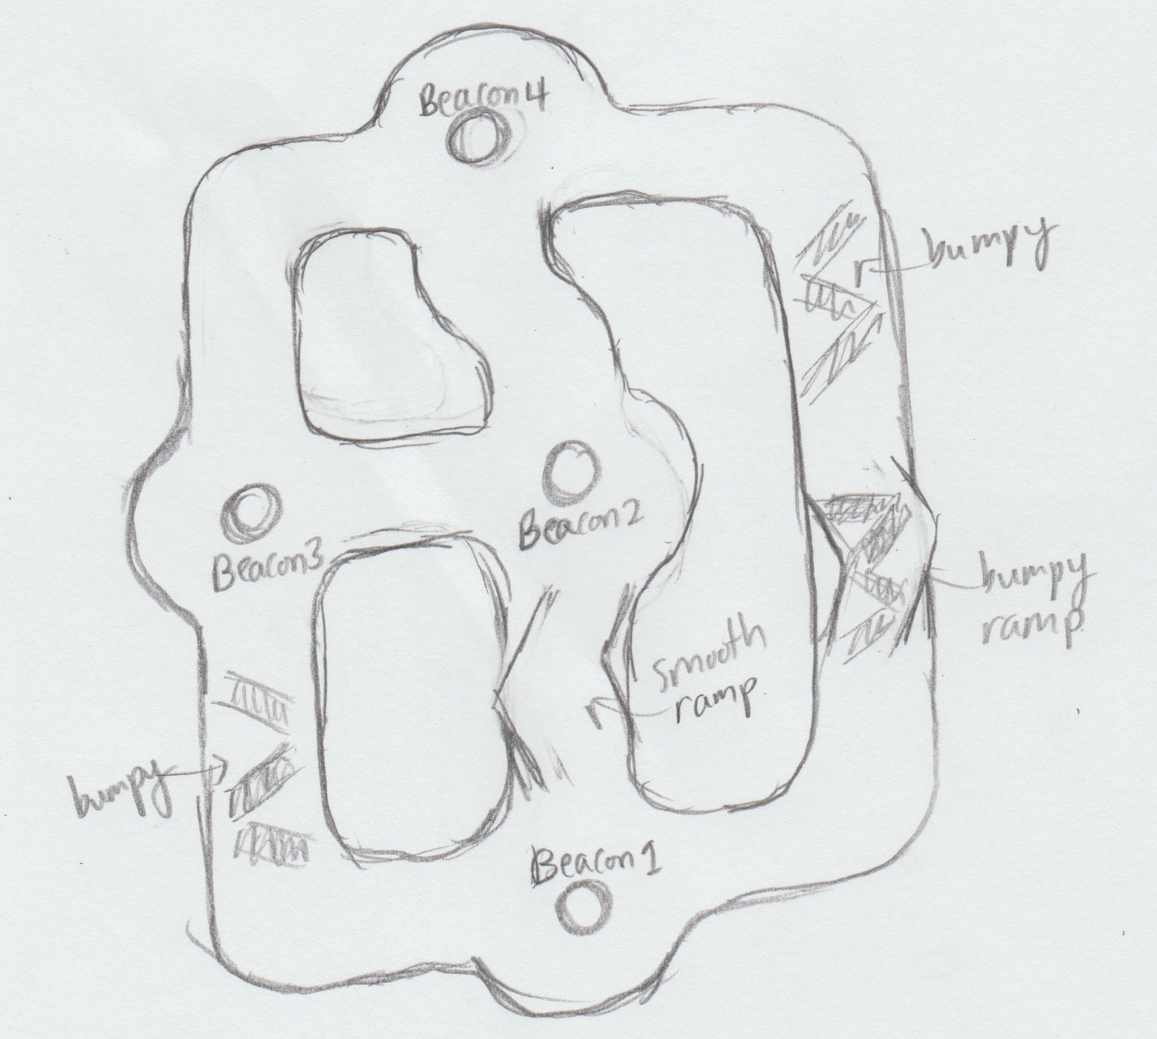
Testing and Verification: Complete System, Diagram of our Maze

Slide 11
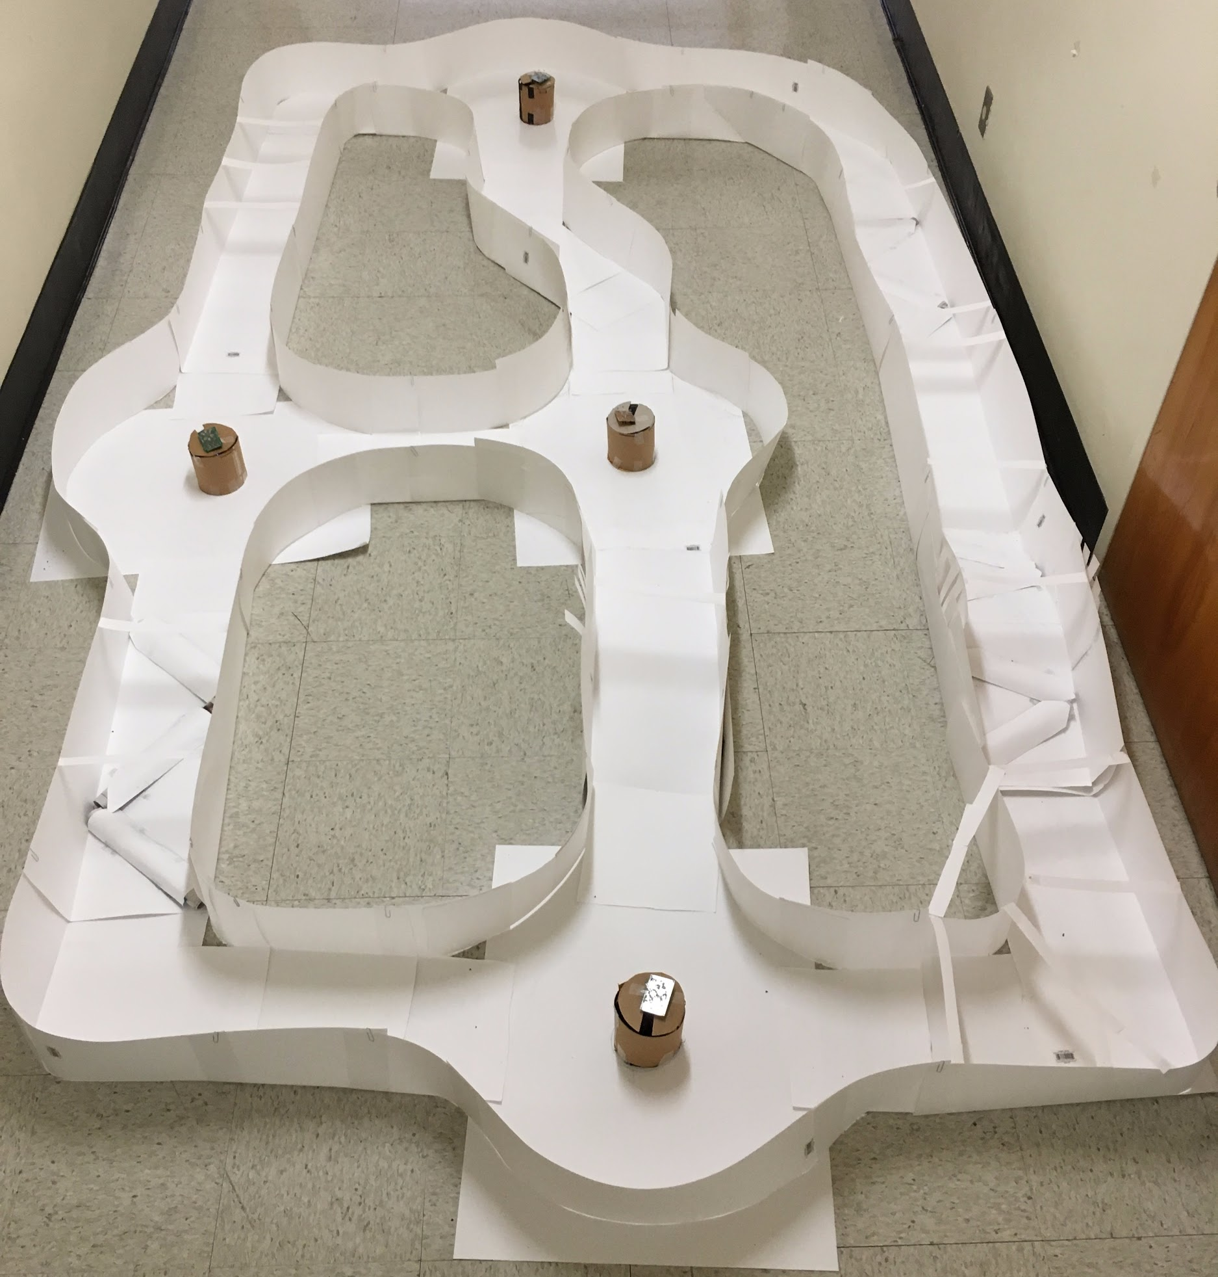
Testing and Verification: Complete System, Picture of Constructed Maze

Slide 12
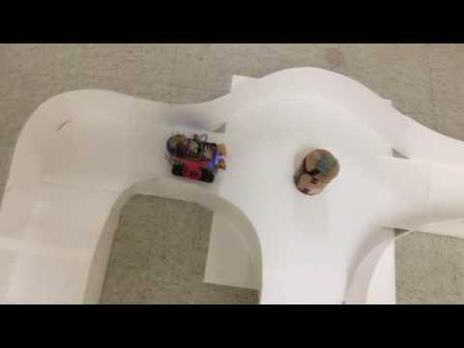
System Demonstration

Slide 13
System Demonstration
Data Recorded by the Robot about the maze:
Destination Beacon: 1, pathTime: 12.218973
Departing Beacon: 1, Destination Beacon: 2, pathTime: 65.551595
Departing Beacon: 2, Destination Beacon: 3, pathTime: 27.529101
Departing Beacon: 3, Destination Beacon: 1, pathTime: 152.009544
Departing Beacon: 1, Destination Beacon: 2, pathTime: 103.064041
Departing Beacon: 2, Destination Beacon: 4, pathTime: 84.125477
Departing Beacon: 4, Destination Beacon: 3, pathTime: 125.368791
Departing Beacon: 3, Destination Beacon: 2, pathTime: 23.823842
Departing Beacon: 2, Destination Beacon: 1, pathTime: 91.673975
Departing Beacon: 1, Destination Beacon: 4, pathTime: 324.434561

Slide 14
Final System Mission Progress Report
Accomplished goals relative to quarter 1:
Completed a robust IR transmitter and receiver communication system.
The robot is able to follow a path and stay in the center of the path under many different conditions (bumpiness and inclines)
The robot is able to circle the beacon and go down a path.
The robot is able to record the time it takes to go down each path and this information can be used for analysis in the future.

Slide 15
Conclusion:
Future Development Opportunities
Future development:
Implement Dijkstra’s algorithm and a special path-node structure to dynamically and autonomously explore all paths.
Replace the motors with higher quality motors so we do not have to pulse the motors anymore to prevent overheating.
Determine the path conditions, including incline and bumpiness.
Have the robot itself process sensor data to determine the optimal path.
Increasing path complexity/removal of defined paths.
Outdoor applications.
Drones!

Slide 16
Resources and References
Differential Manchester encoding: https://en.wikipedia.org/wiki/Differential_Manchester_encoding
IR Beacon Localization: http://erem.ktu.lt/index.php/elt/article/viewFile/1046/1127

Slide 17
Robot
Edison 2
Receiver
Thread 1
Thread 2
(control)
Motors
Receiver
Receiver
UART
Receiver
9DOF
Thread 1
Thread 2
Receiver
Receiver
Edison 1
Ultrasonic
Ultrasonic
Ultrasonic
Ultrasonic
Ultrasonic

